Slide 1

Project Title: Testing the functionality of e-commerce application using Selenium tool
Software Tool: Selenium WebDriver
By
Nikhil Shahane

Slide 2
Types of Web Application Testing Tool
1.Selenium
2.Katalon Studio
3.CasperJS
4.Screenster
5.SoapUI
6.Sahi
7.Watin
8.Watir
9.QTP (UFT)
10.Lambda test

Slide 3
Why Selenium Tool?
Selenium WebDriver can support multiple languages like Java, Python, JavaScript, C# and so on.
Selenium Webdriver can be used to test an application in multiple browsers like Chrome, Firefox, Safari, IE
Selenium Webdriver can be used to stimulate human-like actions like drag and drop, keypress, click and hold, and so on.
Selenium Webdriver has the ability to test more than one device like Android, Blackberry, and iPhones
The Selenium Webdriver tool is used for automating web application testing to verify that it works as expected or not

Slide 4
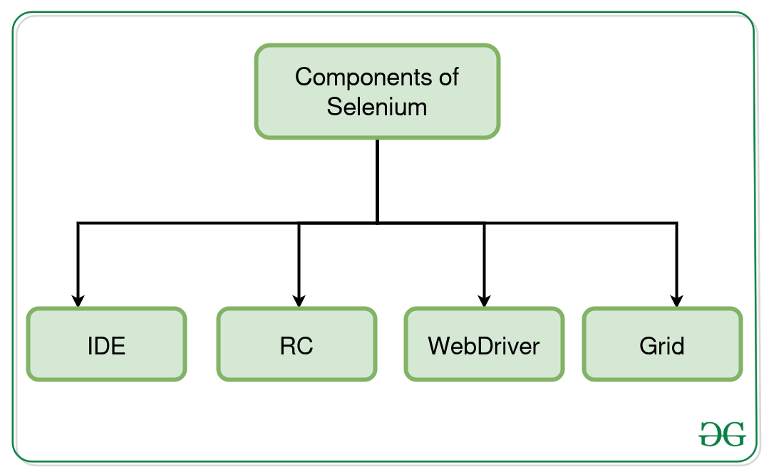
Selenium Components

Slide 5
Selenium Webdriver:
Selenium Webdriver can support multiple languages like Java, Python, JavaScript, C# and so on.
Selenium Webdriver can be used to test an application in multiple browsers like Chrome, Firefox, Safari, IE
Selenium Webdriver can be used to stimulate human-like actions like drag and drop, keypress, click and hold, and so on.
Selenium Webdriver has the ability to test more than one device like Android, Blackberry, and iPhones
The Selenium Webdriver tool is used for automating web application testing to verify that it works as expected or not

Slide 6
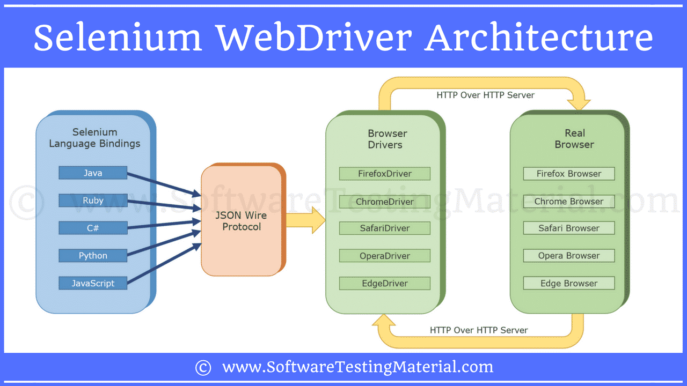
Selenium Architecture

Slide 7
Project Introduction
In this project I have mentioned about what are the methods and commands used for testing the e commerce application
By using selenium Webdriver we can test the application on user point of view
In this project I have tested the e commerce application basic functionality like purchasing a product, search any product in the search icon and sign
I have mentioned about What are the benefits and difficulties faced while using the selenium software
Test case and test Scenario I have mentioned in the project

Slide 8

Why e-commerce application?
E-commerce (electronic commerce) is the activity of electronically buying or selling of products on online services or over the Internet.
E-commerce application most of the user are using in this world

Slide 9
Defects User Facing?
In e-commerce website after entering password and username sometimes user couldn’t login
Searching result may not shown after selecting a search icon
Add to cart option is not properly working
Some times user will not get the confirmation message
User try to cancel the order but misalignment or missing information in the chatbot
When user enters valid credential values in payment part but sometimes it may show payment failed
User not able to track a product

Slide 10
Modules Used In Project
Sign-in module
To check user able to sign-in the application by entering the credential values in User name and password text box
Search a product name
To check user able to search a product name in the search icon after selecting search icon user gets the result or not

Slide 11
Types of Commands
Browser commands
Navigation commands
Web element commands
Browser commands:
All the commands are associated with browser is known as browser commands
Navigation commands:
By using the navigation commands we can check the browser moments
Web element commands:
List of action that can be performed on various web elements

Slide 12
Method used in project
System set property()
Find Element()
Send Keys()
Maximize()
Sleep()
Submit()

Slide 13
Methods Used In Project
Browser commands
Navigation commands
Web element commands
Browser commands:
All the commands are associated with browser is known as browser commands
Navigation commands:
By using the navigation commands we can check the browser moments
Web element commands:
List of action that can be performed on various web elements

Slide 14
Find Element
The selenium find element is the command that is used to identify a web element within a web page in a unique way, and it returns the first matching web element;
It contains any set of web locator elements using id and name we can pass the data's to identified the data's with default methods
like find Element() with default parameters like find Element(By.id(<element ID)) and find Element(By.name(<element-name)) for each set of commands

Slide 15
Element Visibility
isEnabled
isSelected
isDisplayed
isEnabled method
isEnabled method is used to test the web element is present on the web page or not
Boolean FirstName= driver.findElement(By.id("fname")).isEnabled(); System.out.print(FirstName);

Slide 16
Sendkeys Method
Identifying the input fields using specific locators. For example, an email address, password field.
Entering values in input boxes explicitly using sendkeys() method
Syntax for sendkeys
Web Element email = driver.findElement(By.id("user email"));
email.sendKeys("---your email id---")

Slide 17
Sleep Method
Thread Class is a class that is basically a thread of execution of the programs. It is present in java.lang.package
The sleep() method is used to stop the execution of the current thread(whichever might be executing in the system) for a specific duration of the time and
After that time duration gets over, the thread which is executing earlier starts to execute again
It does not return any value, i.e., the return type of the sleep function is void.
Millis: Duration of time in milliseconds for which thread will sleep

Slide 18
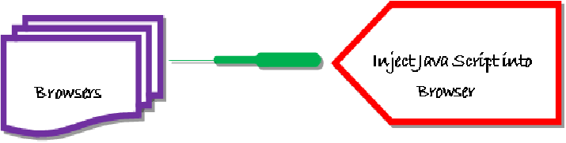
Java Script executor
JavaScript Executor is an Interface that helps to execute java script through selenium Webdriver
JavaScript Executor provides two methods “executeScript” & “executeAsyncScript” to run JavaScript on the selected window or current page.

Slide 19
Locators
Locating elements in Selenium WebDriver is performed with the help of find Element() and find Elements() methods provided by WebDriver and Web Element class.
Types of locators
id
Name
Link text
Partial Link text
Tag Name
Class Name
CSS
Xpath

Slide 20
Locator Types
Method | Syntax | Description
By ID | driver.findElement(By.id (<element ID>)) | Locates an element using the ID attribute
By name | driver.findElement(By.name (<element name>)) | Locates an element using the Name attribute
By class name | driver.findElement(By.className (<element class>)) | Locates an element using the Class attribute
By tag name | driver.findElement(By.tagName (<htmltagname>)) | Locates an element using the HTML tag
By link text | driver.findElement(By.linkText (<linktext>)) | Locates a link using link text
By partial link text | driver.findElement(By.partialLinkText (<linktext>)) | Locates a link using the link's partial text
By CSS | driver.findElement(By.cssSelector (<css selector>)) | Locates an element using the CSS selector
By XPath | driver.findElement(By.xpath (<xpath>)) | Locates an element using XPath query

Slide 21
Test Case
The test case is an in-details document that includes all possible inputs such as positive and negative, and the navigation steps. These are implemented during the testing process to check whether the software application is performing the task for that it was developed or not.
Test scenario
It is a detailed document of test cases that cover end to end functionality of a software application in liner statements. The test scenario is a high-level classification of testable requirements. Before performing the test scenario, the test engineer needs to consider the test cases for each scenario.

Slide 22
Test Scenario
Module name | Test scenario | Test case | No of test case
Sign in module | Ts_001 | To check user able to sign in a page | 1
Select item module | Ts_002 | To check user able to select item | 2

Slide 23
Test Case
Test case ID | Test scenario | Test case | Pre condition | Test step | Test data | Expected result | Actual result
Tc_001 | Ts_001 | User select sign option and enters Valid username and password | User need a valid email account | Enter username Enter password | Valid username Valid password | It should display a successful sign page | It is displayed a successful sign page
Tc_002 | Ts_002 | User select search icon Enter product name | User need a valid email account | Enter a product and name select search icon | Valid product name | It should displays the product result | It is displayed The product result

Slide 24
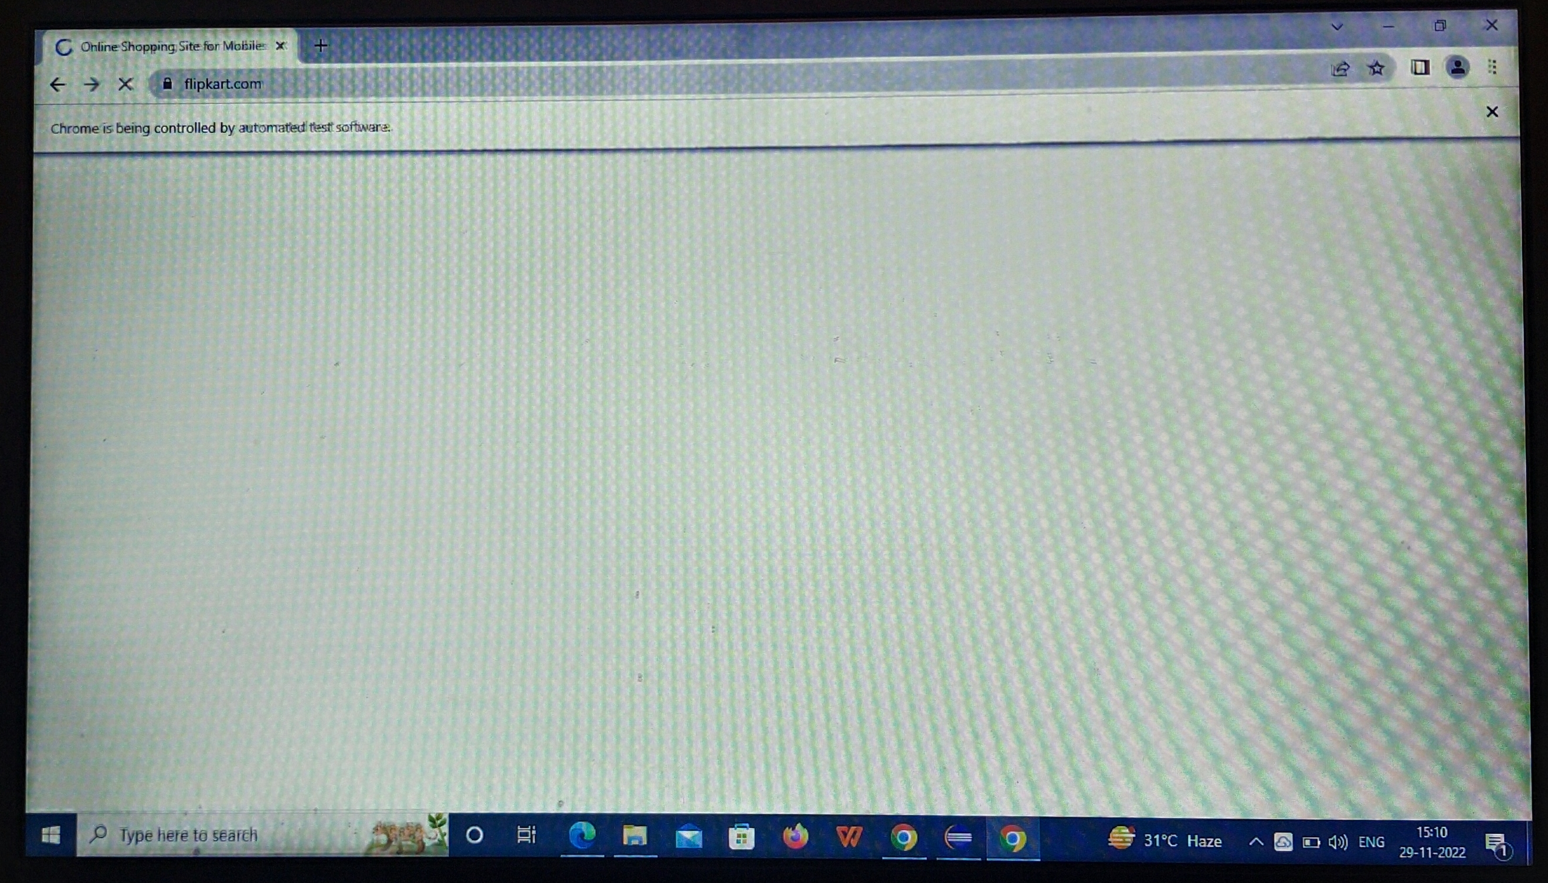
Project Searching Website Page

Slide 25
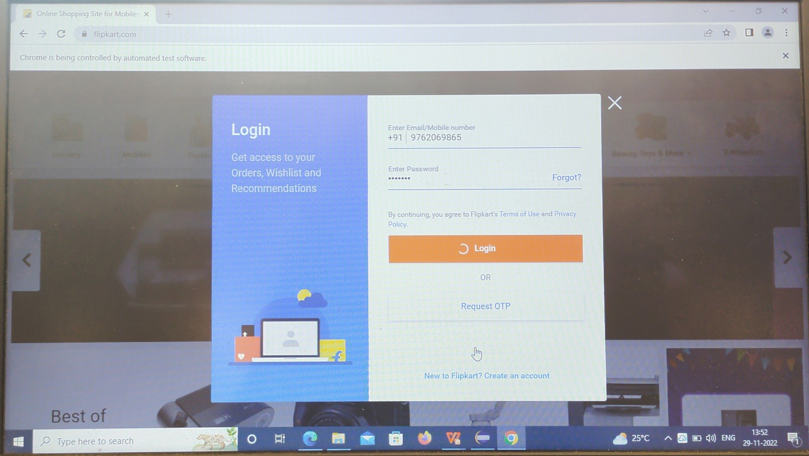
Sign Up Page

Slide 26
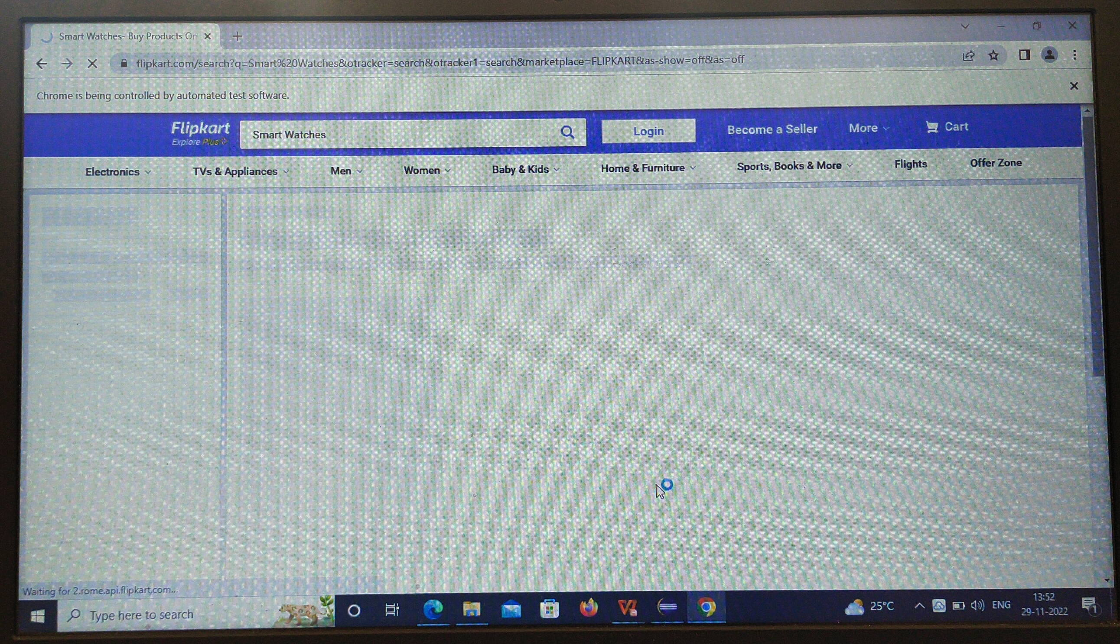
Searching of Product Page

Slide 27
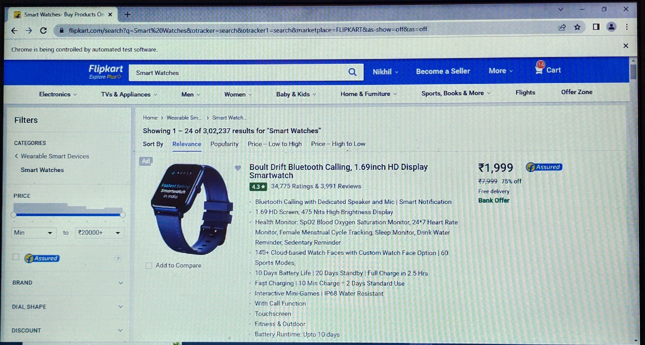
Project Product Selection Page

Slide 28
Advantages of Selenium Webdriver
Selenium IDE worked only in Mozilla while RC and WebDriver work in IE, Chrome, Firefox, Opera, Safari and many other browsers.
Selenium is an Open Source Software.
Selenium supports various programming languages to write programs (Test scripts)
WebDriver test cases execute faster when compared to the other tools of the Selenium suite.
It is very easy to locate web elements with the help of an ID, class, name, XPath, etc.
Selenium WebDriver supports automation of test scripts across the various devices, which can be BlackBerry, Android, and iPhones.

Slide 29
Drawbacks of Software
Finding the element by using the locator sometimes not all the times we may not find any attributes names.
So that time we can use Xpath to find the locator of element.
But even through when we mention correct locator also sometimes it will throw an exception to avoid it.

